Slide 1

LBNL Emulation
From OpenBuilding Control – Working Report for Process and Software Development https://github.com/lbl-srg/obc/blob/master/meetings/2017-11-tag/cdl_report.pdf https://github.com/lbl-srg/obc http://obc.lbl.gov/ Thank you to Michael Wetter, Jianjun Hu, Milica Grahovac, Philip Haves, and OBC Team.
David Blum
Postdoctoral Fellow
Building Technology and Urban Systems Division
Lawrence Berkeley National laboratory
Office: 90-3145
Phone: +1 (510) 486-4741
Email: dhblum@lbl.gov

Slide 2
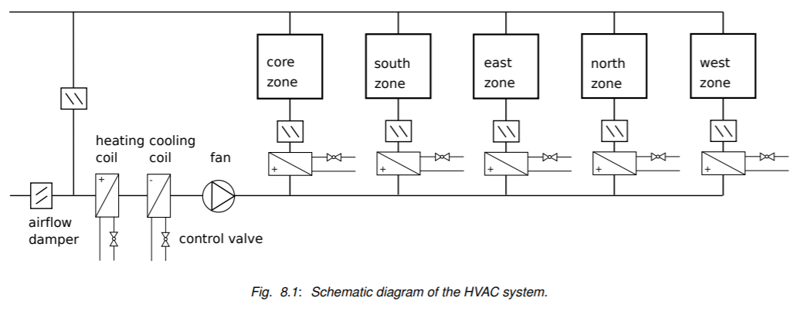
Building Description
One Middle Floor, 5-Zone
VAV air system with ideal plant heating and cooling
ASHRAE Standard 90.1-2004 Construction
Includes envelope leakage, and open-door air flow based on wind and HVAC flow imbalances
Based on U.S. DOE Commercial Building Benchmark

Slide 3
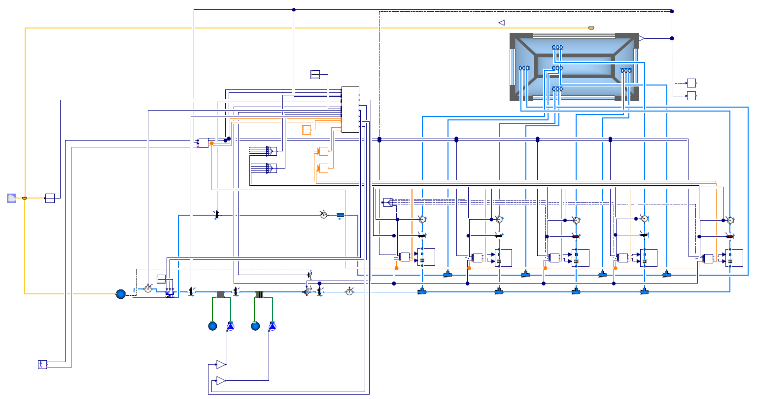
Implementation
Quantity | Base | G36
# Components | 2826 | 4400
# Variables | 33,700 | 40,400
# Continuous States | 178 | 190
# Time-varying Variables | 3400 | 4800
Time for Annual Simulation (minutes) | 70 | 100
Modelica Buildings Library
Controls Description Language (CDL)
Case Base: VAV 2A2-21232 of the Sequences of Operation for Common HVAC Systems (ASHRAE 2006) Buildings.Examples.VAVReheat.ASHRAE2006
Case G36: ASHRAE Guideline 36 Multi-Zone VAV Control Sequence Buildings.Examples.VAVReheat.Guideline36
Radau with Tolerance 10-6 – variable timestep solver

Slide 4
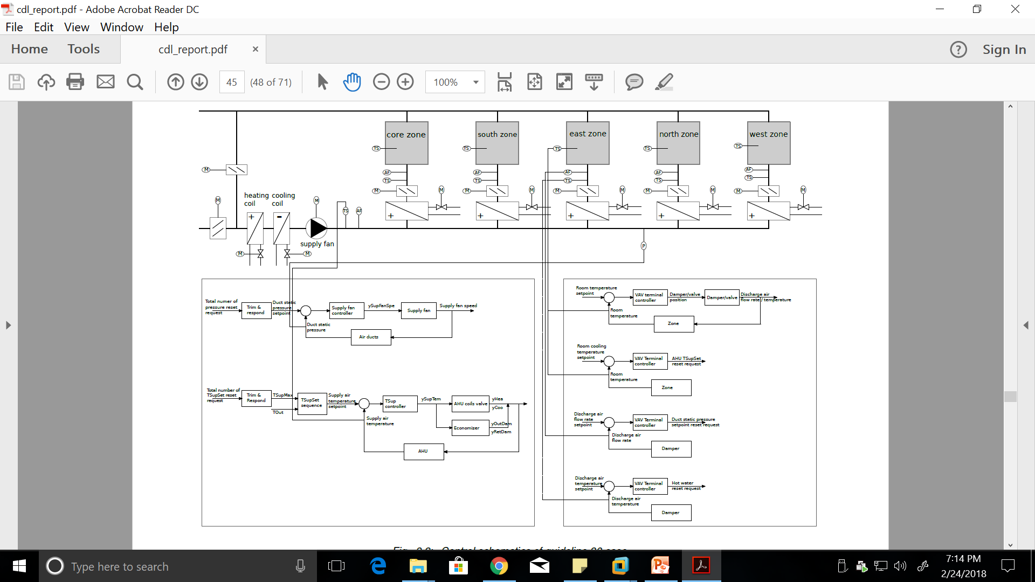
ASHRAE Guideline 36 Controls

Slide 5
AHU Local Loop Controllers

Slide 6
Zone Level Local Loop Controllers

